Slide 1
Council of Great City Schools Public Relations Executive Meeting July, 2012
EAST BATON ROUGE PARISH SCHOOL SYSTEM

Slide 2
DISTRICT INFORMATION

Slide 3
District Information
Student Population – 43,300
82% Minority
86% Free/Reduced
9% ESS
School Sites – 85
9 Blue Ribbon
Employees
6,200 Total
3,750 Teachers

Slide 4
Important Dates
August 2005
Hurricane Katrina
Over 9,000 students enrolled in one week
Over 3,000 permanent students
Rebuilding
July 2007
Consent Decree
One of the longest desegregation cases in U.S. history
April 2009
SACS CASI District Accreditation

Slide 5
SACS CASI
RECOMMENDATION:
“A communitywide marketing strategy should be designed and implemented to address the perceptual gap concerning the quality of education provided by EBR schools.”

Slide 6
Goal
Generate positive brand perception for EBRPSS by:
Connecting emotionally
Making it relevant
In order to: Raise morale/instill pride
Change perception

Slide 7
Audience
Internal
Primary Students/Parents
Teachers/Principals
Superintendent/School Board
Non-teaching staff (bus drivers, cafeteria, etc.)
External
Primary
Residents who live in EBR parish
Parents with kids in private schools
Media
Local National Trade Social Media
Secondary: Community-at-large Business/Chamber of Commerce
Government/Local Law Enforcement
District Retirees

Slide 8
Perception is Reality in the Absence of Information

Slide 9
RESEARCH

Slide 10
Surveys
Internal and External
Internal Interviews
Leadership Team
Schools
District Highlights
Board Members
Local Public Relations Professionals

Slide 11
PLANNING

Slide 12
Board Approval
Budget
Outside Marketing Company
Zehnder Communications

Slide 13
Messaging
What do we want to tell them? “You think you know East Baton Rouge Parish Schools?” “We’ll Make You Think!”

Slide 14
How do we want to tell them? Messengers - Students Heroes - Alumni

Slide 15
IMPLEMENTATION

Slide 16
Soft Launch
Print
Microsite – thinkebrschools.com
Radio
Media Coverage
Social Media
Hard Launch
Internal Emails
External ENews
Television Spots

Slide 20
Microsite thinkebrschools.com
Complements the campaign and creates “buzz”
Includes the “We’ll Make You Think” video
Highlights the facts and allows visitors to share those facts with others via various means of digital communication
Contains a viral marketing component of interactive thought clouds that can be used to send short messages through social media sites and email

Slide 21
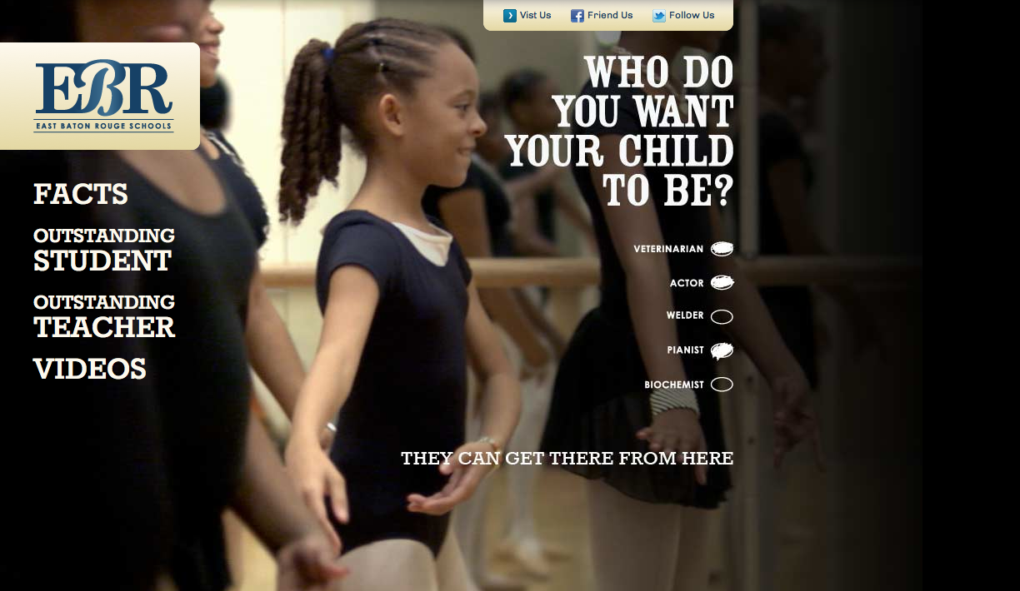
Microsite

Slide 22
Media Overview
Objectives
Generate positive brand perception and instill pride
Schedule media to achieve consistent flighting January – May for continuous reinforcement of brand message
Audience
Due to broad-based audience, media buying was targeted to adults 25-54

Slide 23
Media Vehicles
Print Ads
Radio
Microsite
Social Media
Video
Television Commercials
Billboards

Slide 24
Television
Broadcast Cable
Broad reach vehicle that quickly created awareness among the Baton Rouge market
Recommended stations included:
WAFB – CBS 9
WBRL – CW 21
WBRZ – ABC 2
WBXH – My Network 39
WGMB – Fox 44
WVLA – NBC 33
Provided reach to our primary audience within East Baton Rouge Parish
Zoned cable allowed for effective and cost-efficient targeting
Recommended networks (based on high reach among adults 25-54):
⬥ ABC Family  BET
⬥ FX  Lifetime
⬥ MSNBC  NICK
⬥ TBS  TNT
⬥ TOON  USA
Notes:
GIVE INTRODUCTION OF VIDEO

Slide 25
“We’ll Make You Think” Video
http://www.thinkebrschools.
Click on video link

Slide 26
EVALUATION

Slide 27
Results
Internal and communitywide surveys were completed at the end of August and offered quantifiable insight into the campaign’s success.

Slide 28
Community Survey Results
The educational programs implemented by the school district will improve student achievement.
2009 – 54%
Students in EBR public schools can achieve at/above the level of other students in Private/Parochial area schools.
2009 – 46%
The public image of the East Baton Rouge Parish School System is improving.
2009 – 44%
2010 – 63%
2011 – 63%
2010 – 56%
2011 – 56%
2010 – 55%
2011 – 52%

Slide 29
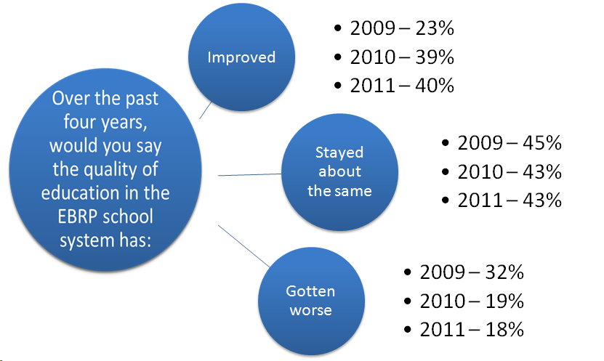
Community Survey Results

Slide 30
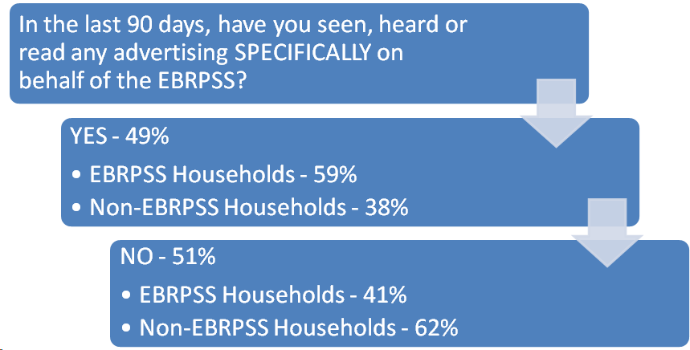
Community Survey Results

Slide 31
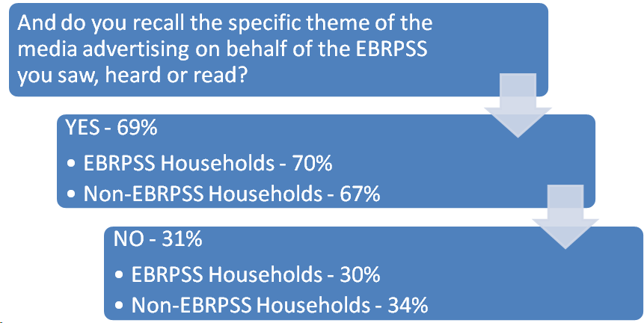
Community Survey Results

Slide 32
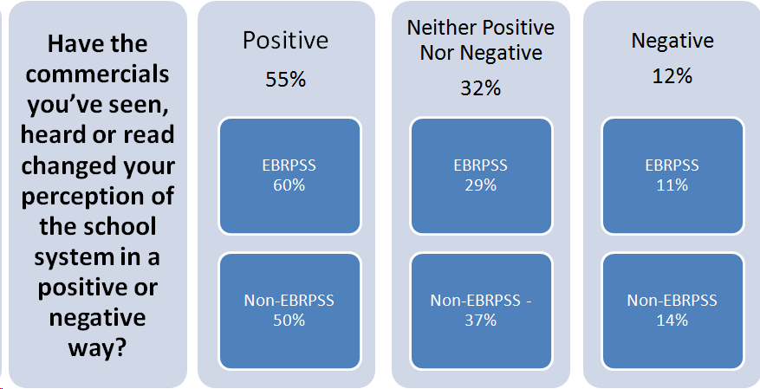
Community Survey Results

Slide 33
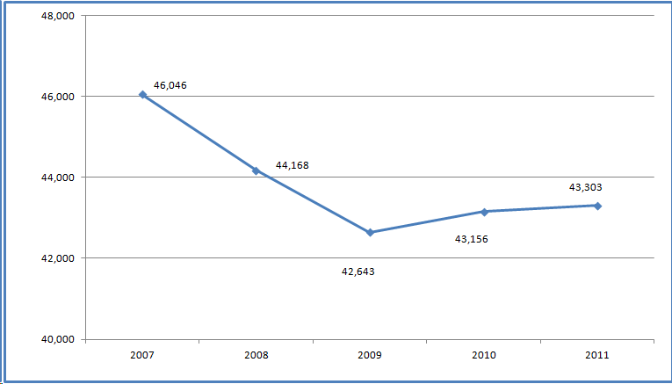
Student Population

Slide 34
Feedback
East Baton Rouge Parish School Board and Executive Leadership Team Members “Congratulations are in order, this is the positive news that will keep our system in excellent performance and acceptance!” -W.T. Winfield, former School Board Member “This is Big League, Chris! Thanks for your hard work.” -Herman Brister, Chief Academic Officer “Outstanding! It’s a quality and classy piece of work. Great Job!” -Jesse Noble, Chief Technology Officer “Thanks, Chris, for making this happen. This prize supports your excellent judgment in the selection process used for this advertising piece. CONGRATULATIONS!!” - Dr. Liz Duran Swinford, former Associate Superintendent for Human Resources

